Slide 1

Network Protocol Abuse : Driving ICS equipment mad
Notes:
Réfléchir pour mettre les reference partout

Slide 2
WORKSHOP
Objective:
Understand Correspondence between memory address and I/O value
Try to get the value from an attacker perspective
Create chaos on the road
Side quest:
Test They previously talk brute force on the web panel of the siemens LOGO!

Slide 3

Erwan Cordier OT/ICS enthousiast
WOAMI
Notes:
Voir pour trouver une meuilleur photo de profils

Slide 4
Disclaimer.
This talk is intended to be informative. I strongly advise against using these techniques to break into computer systems . All content is for educational purposes only.
My personal goal was to see how easy it was to setup a real attack on a common attack vector (Credential Bruteforce).
I am not an expert in this field, the things I am going to show you have been done on my free time, if you see a mistake do not hesitate to correct it.
Notes:
Mettre des numéros sur les slide.
Ne pas surcharger les slide
Réfléchir pour ajouter plus d’image , mais bien utiliser

Slide 5
Foreword
Industrial Control System:
ICS include supervisory control and data acquisition systems used to control geographically dispersed assets
Acronyms:
SCADA : Supervisory Control And Data Acquisition
PLC : Programmable Logic Controller (meant for local use, depend on high-speed, wired connections)
OT : Operational Technologie
ICS : Industrial Control System
Notes:
Ajouter des tab et de point
Voir les fautes.
Revoir peut étre la définitions d’ICS (plus sur le contrôle de systéme phisique)

Slide 6
Local lab setup for test & POC’s
Why set up a local test environment?
Test the POC in a controlled environment.
Greatly reduces the error rate when already tested.
Modifications for better exploitability.
Creations of detections rules.
Made some small scale governance.
Notes:
Photo de la valise. A ajouter (donne un coup en plus pour ).

Slide 7
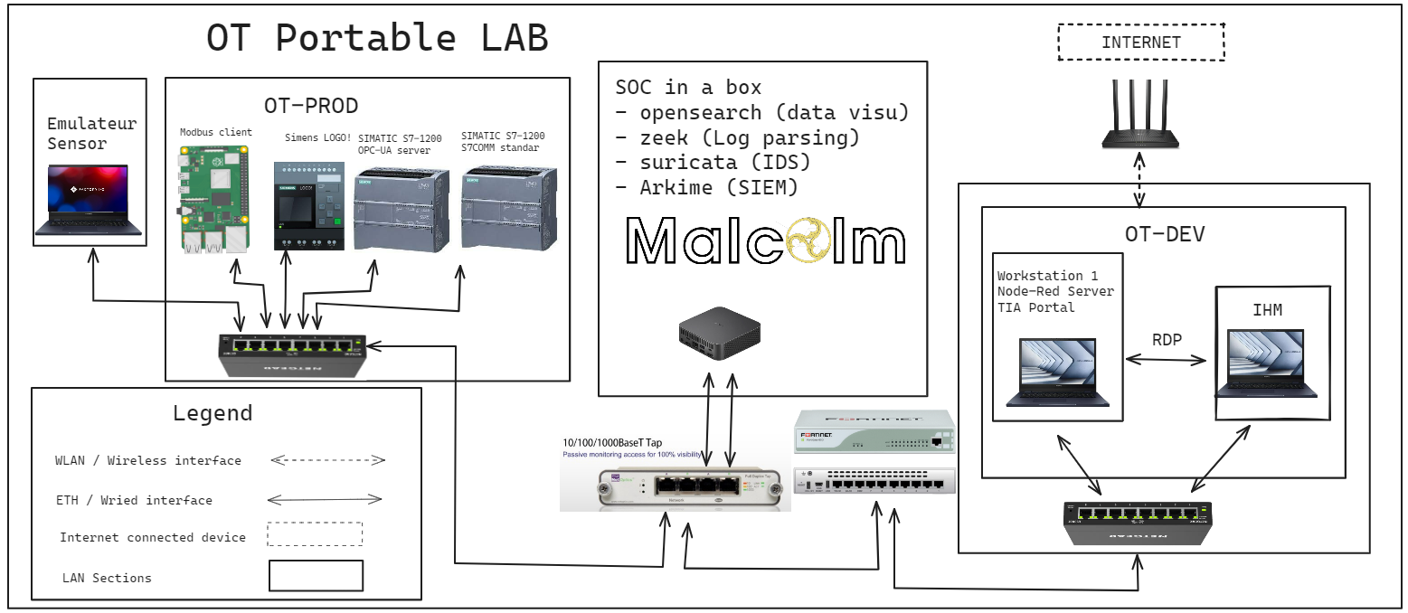
Workshop teasing.
Notes:
Enlever les adresse IP
Revoir la charte graphique de l’excalidraw.

Slide 8

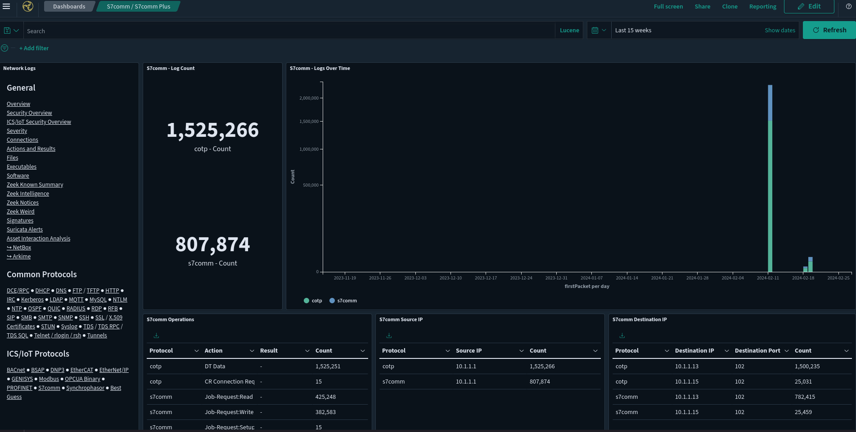
SIEM & detections

Slide 9
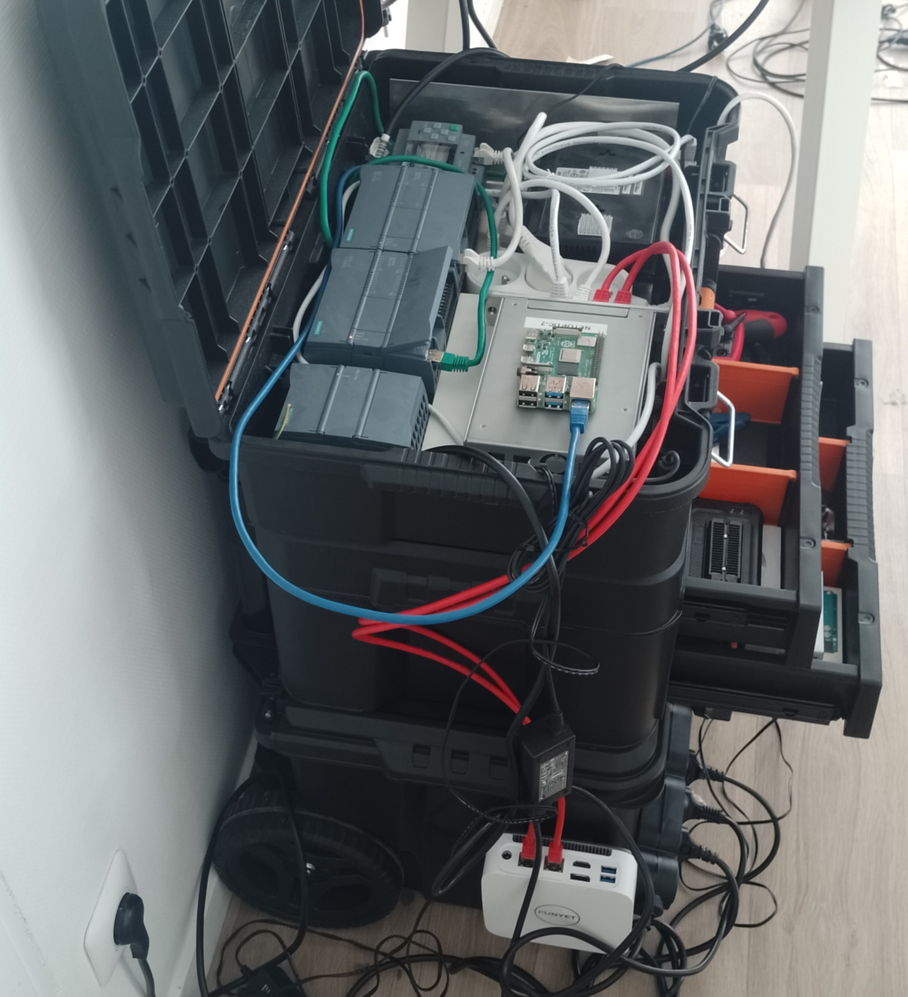
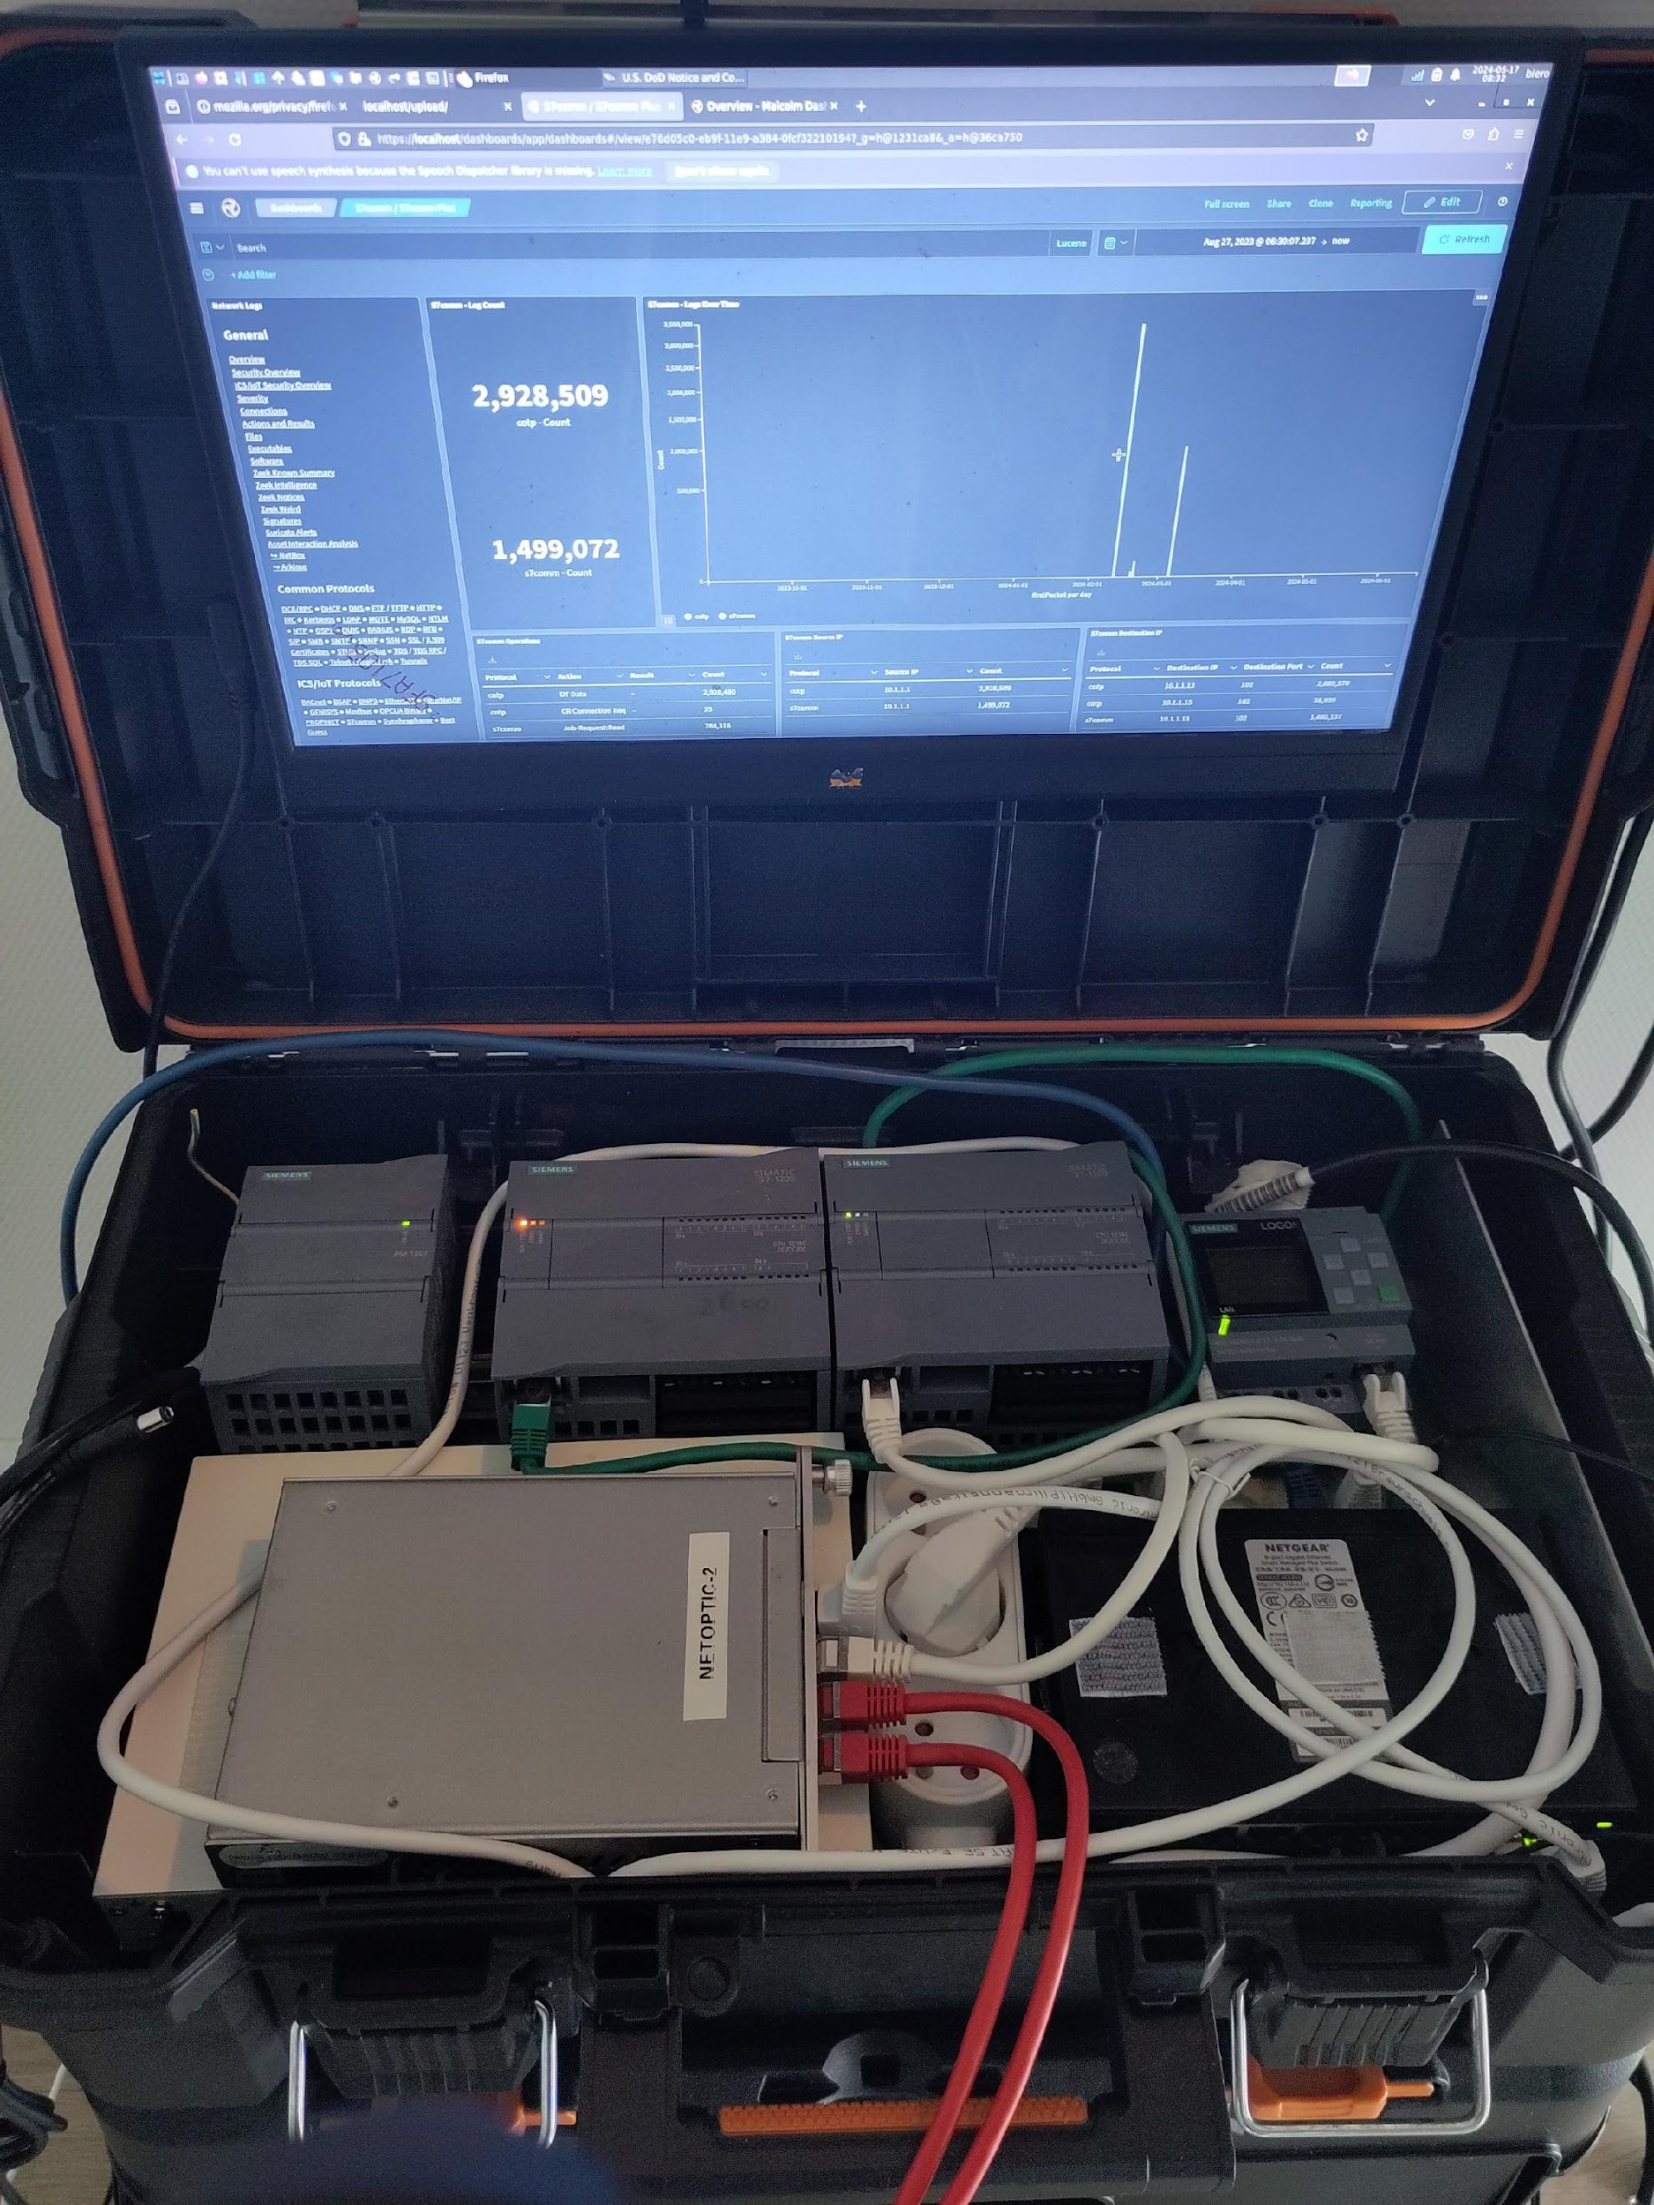
Workshop teasing.
Notes:
Enlever les adresse IP
Revoir la charte graphique de l’excalidraw.

Slide 10
Little bit of governance.
Stardard and guidance.
IEC 62443 : main series of standart for Industrial cybersecurity.
NIST SP 800-82 : NIST special publications That protide guidance for securing SCADA and DCS environement (free).
NERC CIP : standards provide a robust security foundation for the bulk electric system's critical cyber assets.
NIST 2 : come in October in eatch EU country.
Notes:
PLCs are built to be production tools used for automated manufacturing.
RTUs are monitoring tools used to prevent and detect maintenance or security issues at remote locations.

Slide 11
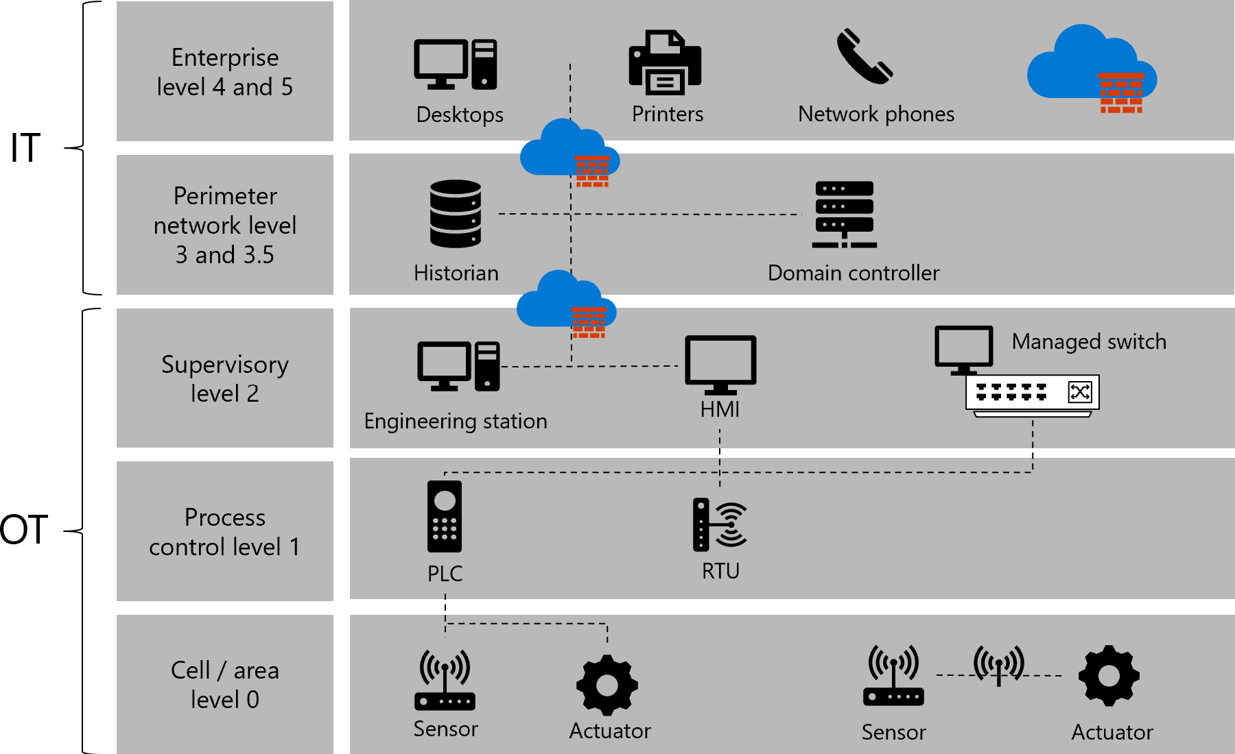
Purdue Model network view of a IT/OT network
Notes:
PLCs are built to be production tools used for automated manufacturing.
RTUs are monitoring tools used to prevent and detect maintenance or security issues at remote locations.
Modèle théorique , n’est pas applicable partout.
Le modèle evolue avec le temps ,
Exemple un capteur connecter qui et connecter directement avec le CLOUD

Slide 12
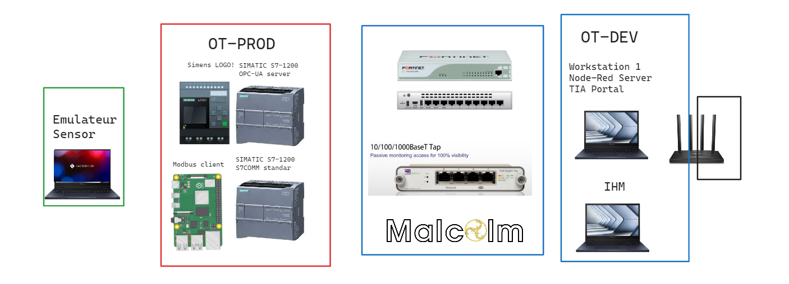
Workshop teasing.
Level 0
Level 1
Level 2
Level 3,5
Notes:
Il y a plusieurs palette

Slide 13
PLC and attack choice.

Slide 14
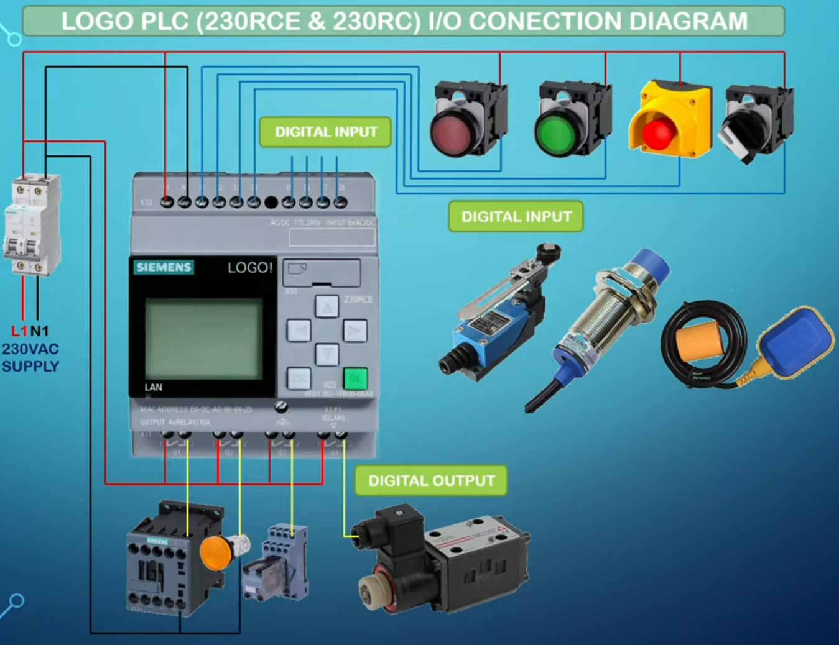
PLC and attack choice.
Always enter a circuit from output to input.
You can connect an output to several inputs, but not several outputs to one input
Notes:
Réfléchir a changer la couleur pour la rendre ^plus lisigble.

Slide 15
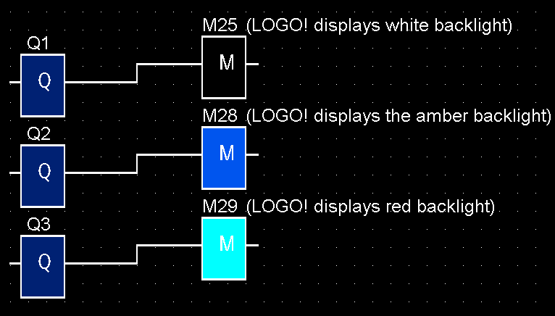
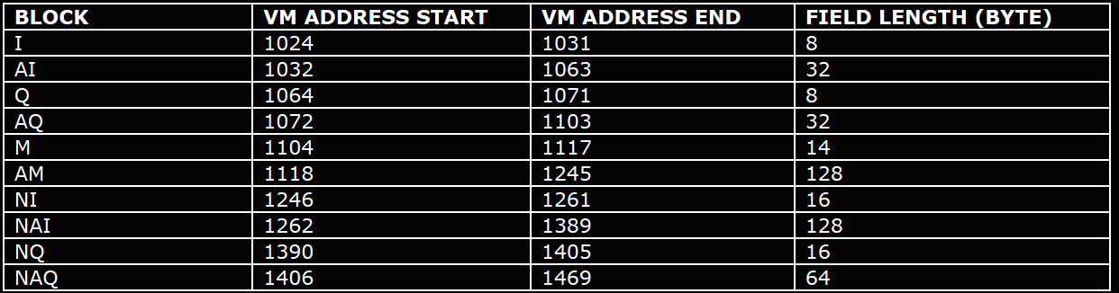
Local lab setup for test & POC’s: example
I = Imput
Q = Output
A = Analog
N = Network
M = Flag
The value is stored in pre-defined memory address.

Slide 16

Local lab setup for test & POC’s: exemple
Snap7 is an open source, 32/64 bit, multi-platform Ethernet communication suite for interfacing natively with Siemens S7 PLCs.
Read the value from the defined memory address to see the possible behavior.
Write the value from the defined memory address to change behavior.
Notes:
Ajouter l’address dans la 1er slide. Peut étre rajouter des commentaires pour dire que les sleep sont la pour prendre en compte la lenteur du PLC.

Slide 17
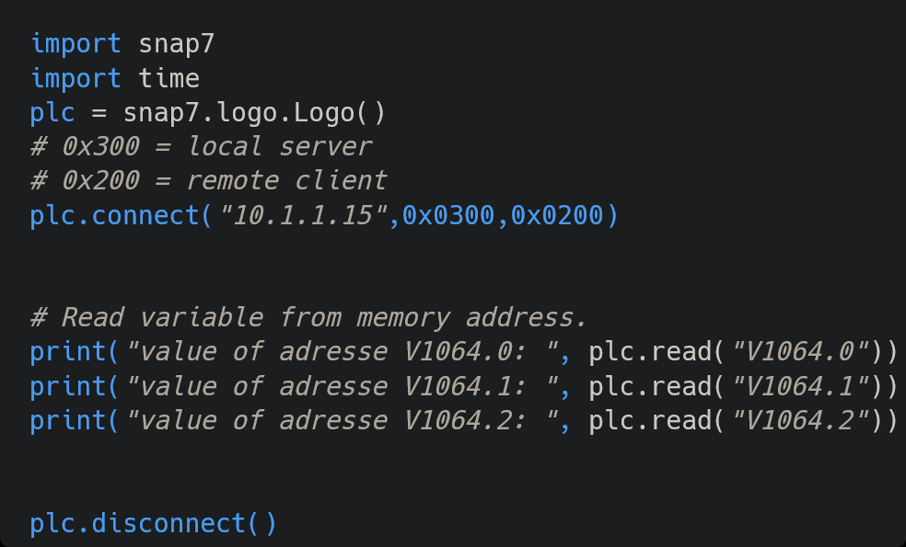
Local lab setup for test & POC’s: exemple
Notes:
Ajouter l’address dans la 1er slide. Peut étre rajouter des commentaires pour dire que les sleep sont la pour prendre en compte la lenteur du PLC.

Slide 18
WORKSHOP: Modbus exercise.
1:
Read the 10 first content from Q1
2:
Write the 10 first content from Q1

Slide 19
WORKSHOP: Modbus
Different tool to forge packet: https://pymodbus.readthedocs.io/en/latest/ https://github.com/sourceperl/mbtget https://scapy.net

Slide 20
WORKSHOP: Modbus exercise.
1:
Read the 10 first content from QX100.0
2:
Write the 10 first content from QX100.0

Slide 21
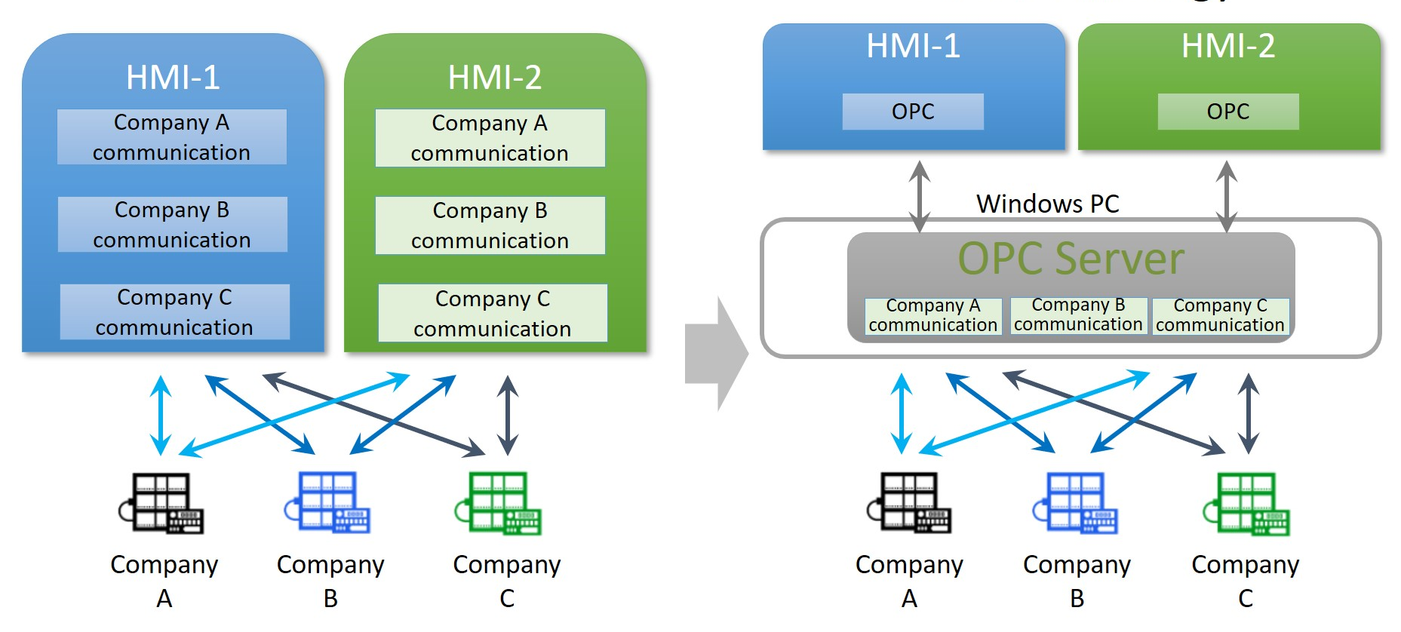
OPC UA

Slide 22

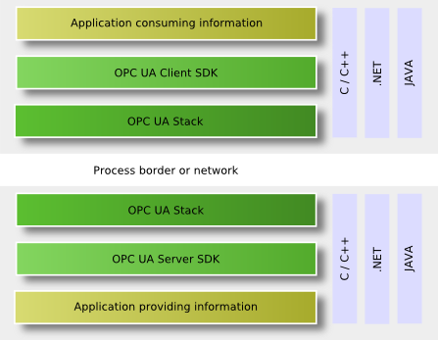
OPC UA

Slide 23
OPC UA
Connect to the OPC UA server of the S7-1200 plc

Slide 24
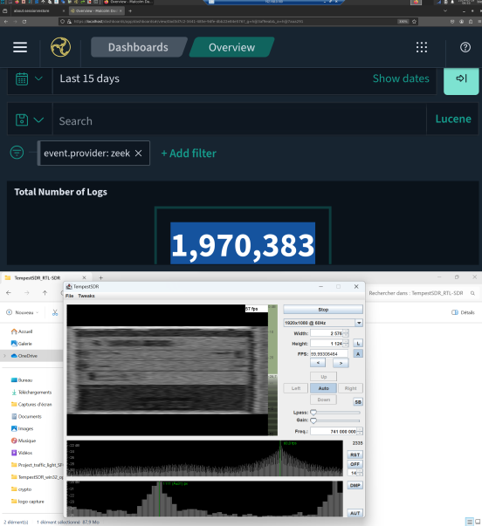
Bonus: SDR tempesting
Try to steal info from the HDMI cable.

